Slide 1
CRP 5680 Urban Spatial Data Analytics
Lab 9 – Integrating ArcGIS Pro with Python notebook

Slide 2
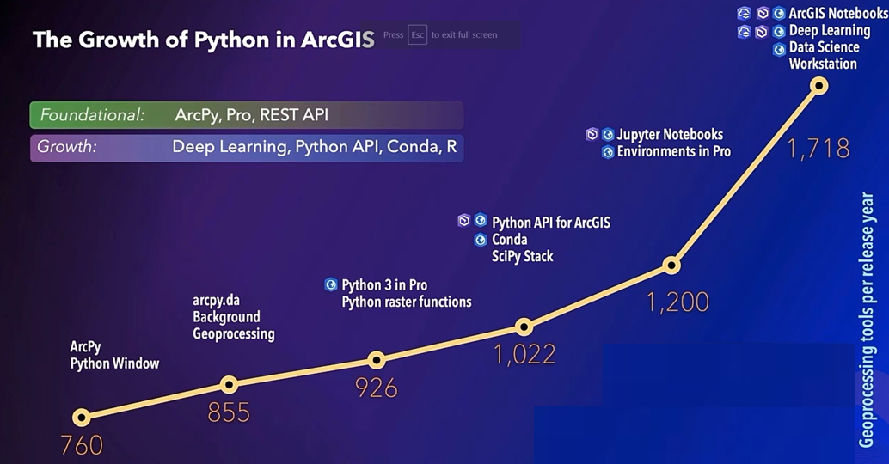
Why ArcGIS Pro + Python?

Slide 3
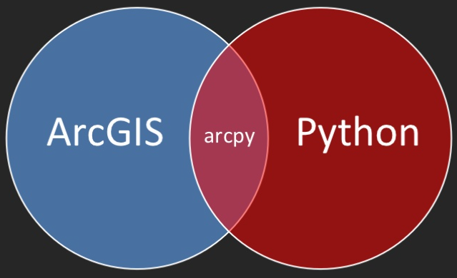
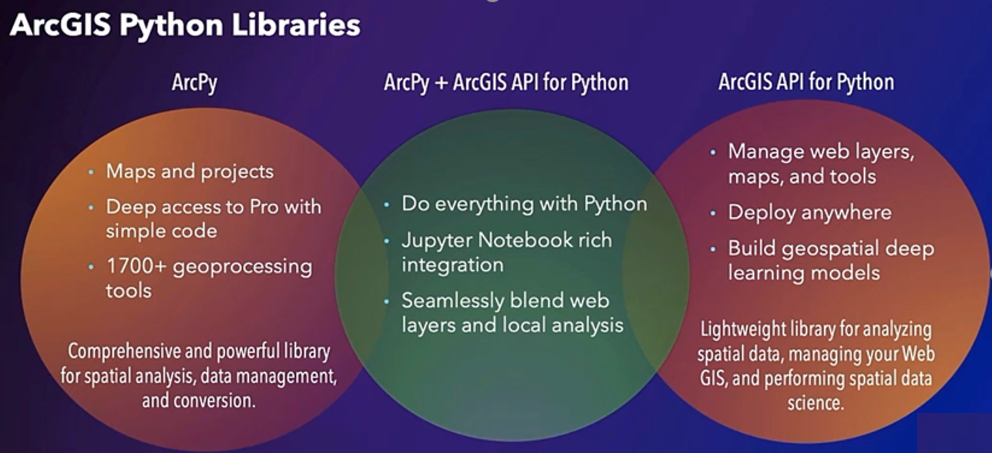
ArcGIS-based Python libraries (packages):
ArcPy (for ArcGIS desktop): a site package of Python that is created to perform geographic data analysis, data conversion, data management, and map automation with Python.
ArcGIS API for Python (for cloud-based/online services, the ESRI Enterprise platforms): A powerful Python library for mapping, spatial analysis, data science, geospatial AI and automation.

Slide 4
Using ArcPy combined with the Python ecosystem, we can:
Automate repetitive tasks
Through loop and for statement
Invoke ArcGIS Pro tools:
geoprocessing tools
raster functions
Python Toolbox for Script Customization
incorporate multiple data sources in your analysis
.shp, .csv, Excel, .tif, Stata…
Conduct aspatial data collection, data management, data visualization, and spatial analysis in a single platform
Pandas, numpy, matplotlib, etc...

Slide 5
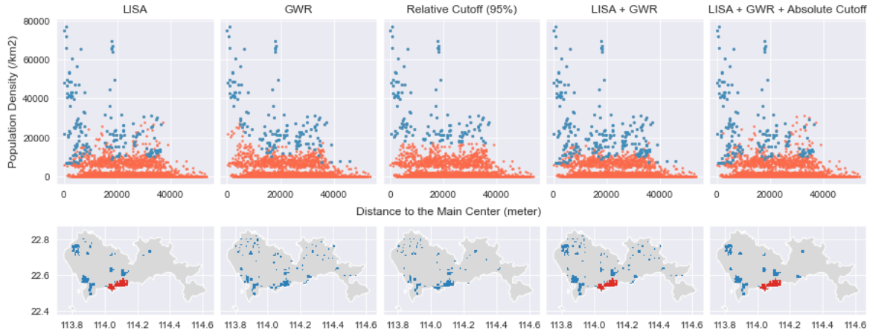
Applications of Combining ArcGIS Pro and Python
Using ArcGIS Pro and Arcpy to identify city centers using ESDA methods
Packages used: Arcpy, matplotlib, seaborn, geopandas
City of Shenzhen, China

Slide 6
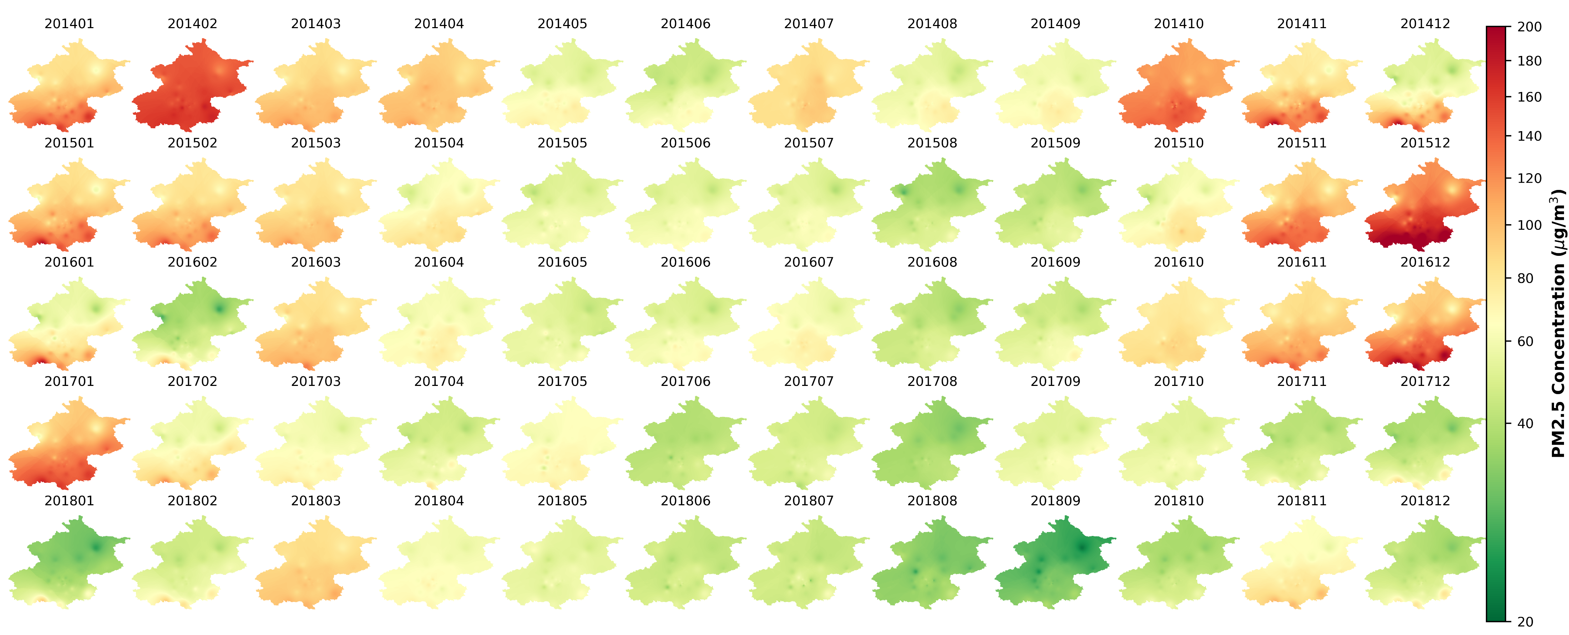
Applications of Combining ArcGIS Pro and Python
Automate the spatial interpolation tools to generate the monthly trend of PM2.5 in Beijing
Packages: Arcpy, rasterio, matplotlib

Slide 7
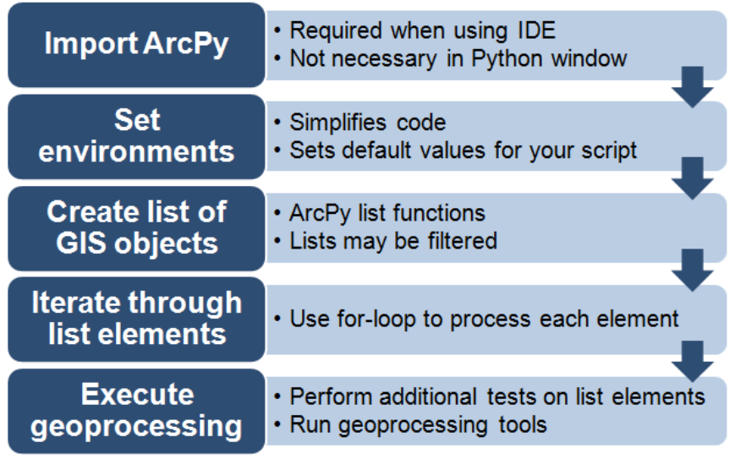
Common scripting workflow
Each Python script that you create will differ depending on the script's purpose. However, many scripts that you write, will use the following workflow.

Slide 8
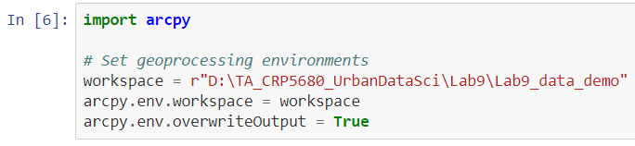
Import the package and set the environment
The overwriteOutput parameter controls whether tools will automatically overwrite any existing output when your script is run.
True: tools will execute and overwrite the output dataset.
False: existing outputs will not be overwritten, and the tool will return an error.

Slide 9
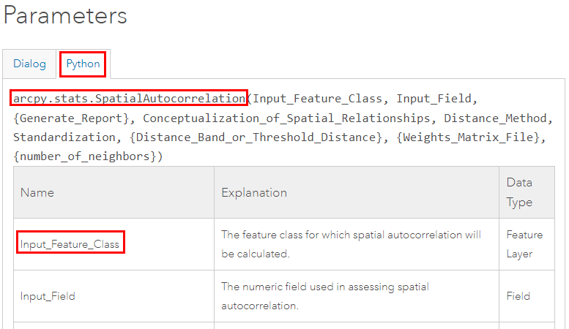
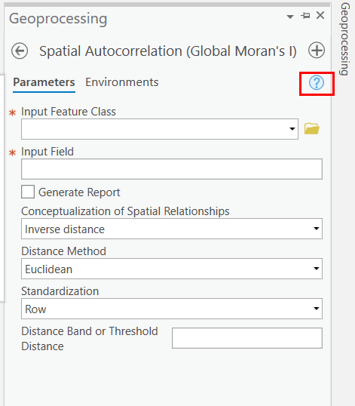
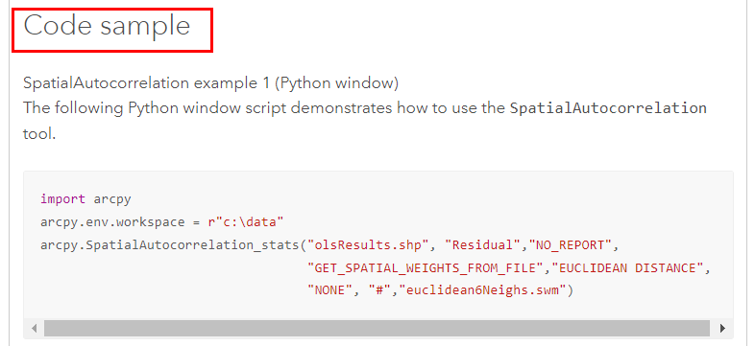
Example of geoprocessing: Moran’s I Index
Tool reference

Slide 10
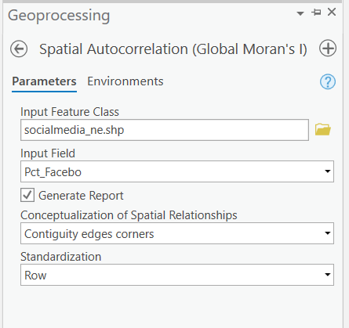
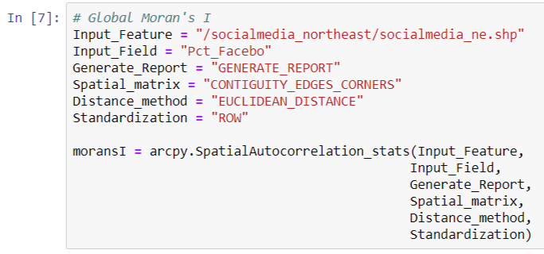
Global Moran’s I: from user interface to python

Slide 11
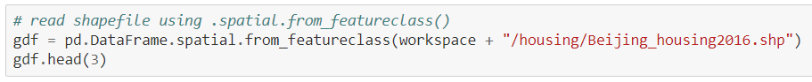
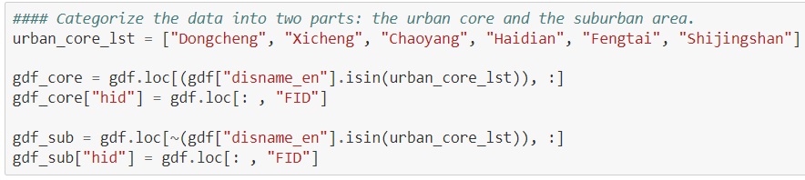
Example of OLS regressions: Arcpy + for-loop
Step 1: read the shapefile as spatially enabled dataframe (SeDF)
Step 2: data management using Pandas: categorize the DF into two parts.

Slide 12
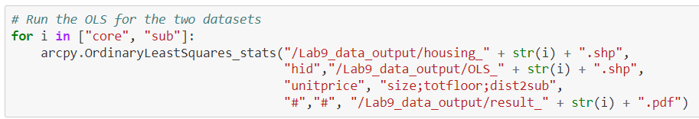
Example of OLS regressions: Arcpy + for-loop
Step 3: write (export) the SeDF to shapefile
Step 4: OLS regressions using the function – OrdinaryLeastSquare_stats:

Slide 13
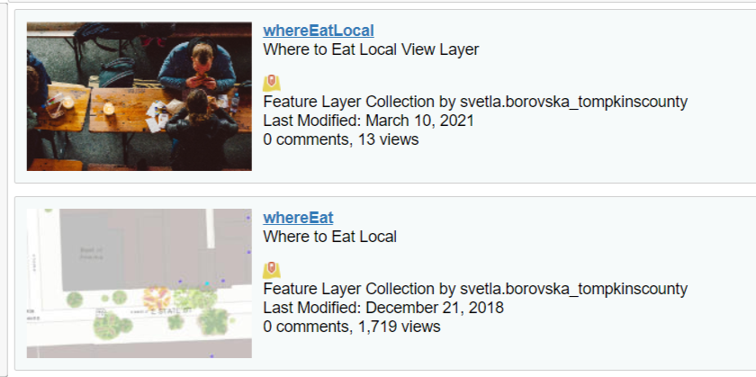
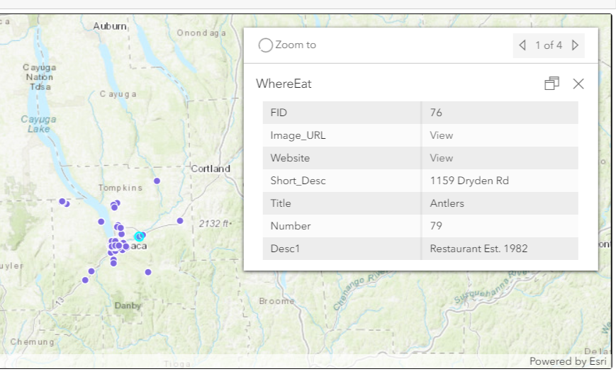
A Brief Introduction of ArcGIS API Python
For cloud-based/online services, the ESRI Enterprise platforms, and ArcGIS Online
Provide APIs for common geospatial functions: distance matrix, network analysis, and geocoding services (but need credits!)
Provide convenient visualization tools and rich data sources. Here is an example of where to eat in Ithaca.

